Slide 1
NAMES
Are you really
who you think you are ?

Slide 2
Mac Son of
O grandson or descendant of
Fitz son of [Norman French]

Slide 3
Edward Catherine
James Elizabeth
William Margaret

Slide 4
Catherine Jane = Josephine
Bridget Alexandra = Angela

Slide 5
Geeno Byrne

Slide 6
Gene O’Beirne
(Eugene O’Beirne)

Slide 7
Fashions in Names
Flower & Jewel Names Lily, Ruby
Celebrities Stanley, Florence
Surnames Todd, Clotworthy, Henthorne
Biblical & Saints’ Names Alphonsus, Leo, Pius, Attracta

Slide 8
John Seán
William Liam
Mary Máire
Ellen Eileen

Slide 9
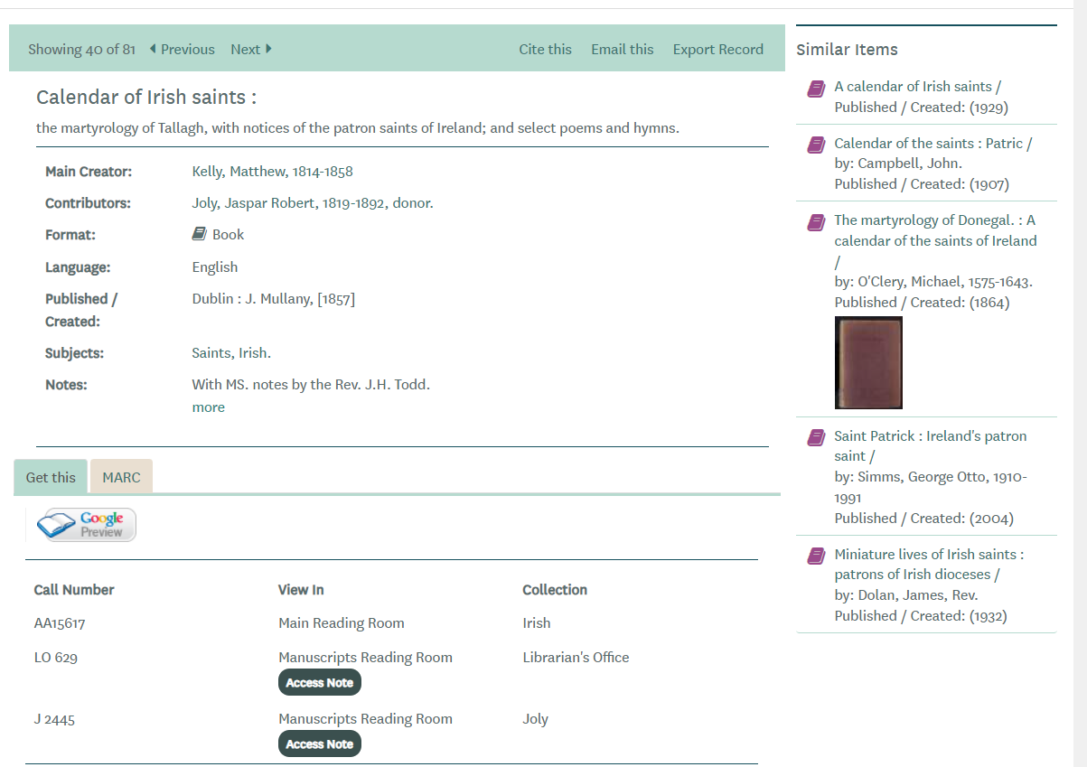
Martyrologies

Slide 10
Names from Mythology
Lugh Lámhfada (Lugh Long-Arm) Louis
Oengus Angus, Eneas
Ailill Elias
Partholan Bartholomew, Bertie

Slide 11
Names of Norse Origin
Olaf Amhlaoibh Humphrey, Oliver
Harald Aralt Harold
Magnus Maghnus Manus, Manasses
Rognvald Raghnall Randal, Randolph, Reginald, Ronald

Slide 12
Traditional Naming Pattern
1st son for father’s father
2nd son for mother’s father
3rd son for the father himself
Similar pattern for the daughters but in some areas the name of the mother’s mother takes preference over the name of the father’s mother

Slide 13
Co. Longford
4th son for the father’s eldest brother
5th son for the mother’s eldest brother
6th son for the father’s second brother
7th son for the mother’s second brother
And so on
Similar pattern for the daughters

Slide 14
The Two Eleanors
Léan Ailéanóir Eleanor
Illen Eibhlín Eleanor

Slide 15
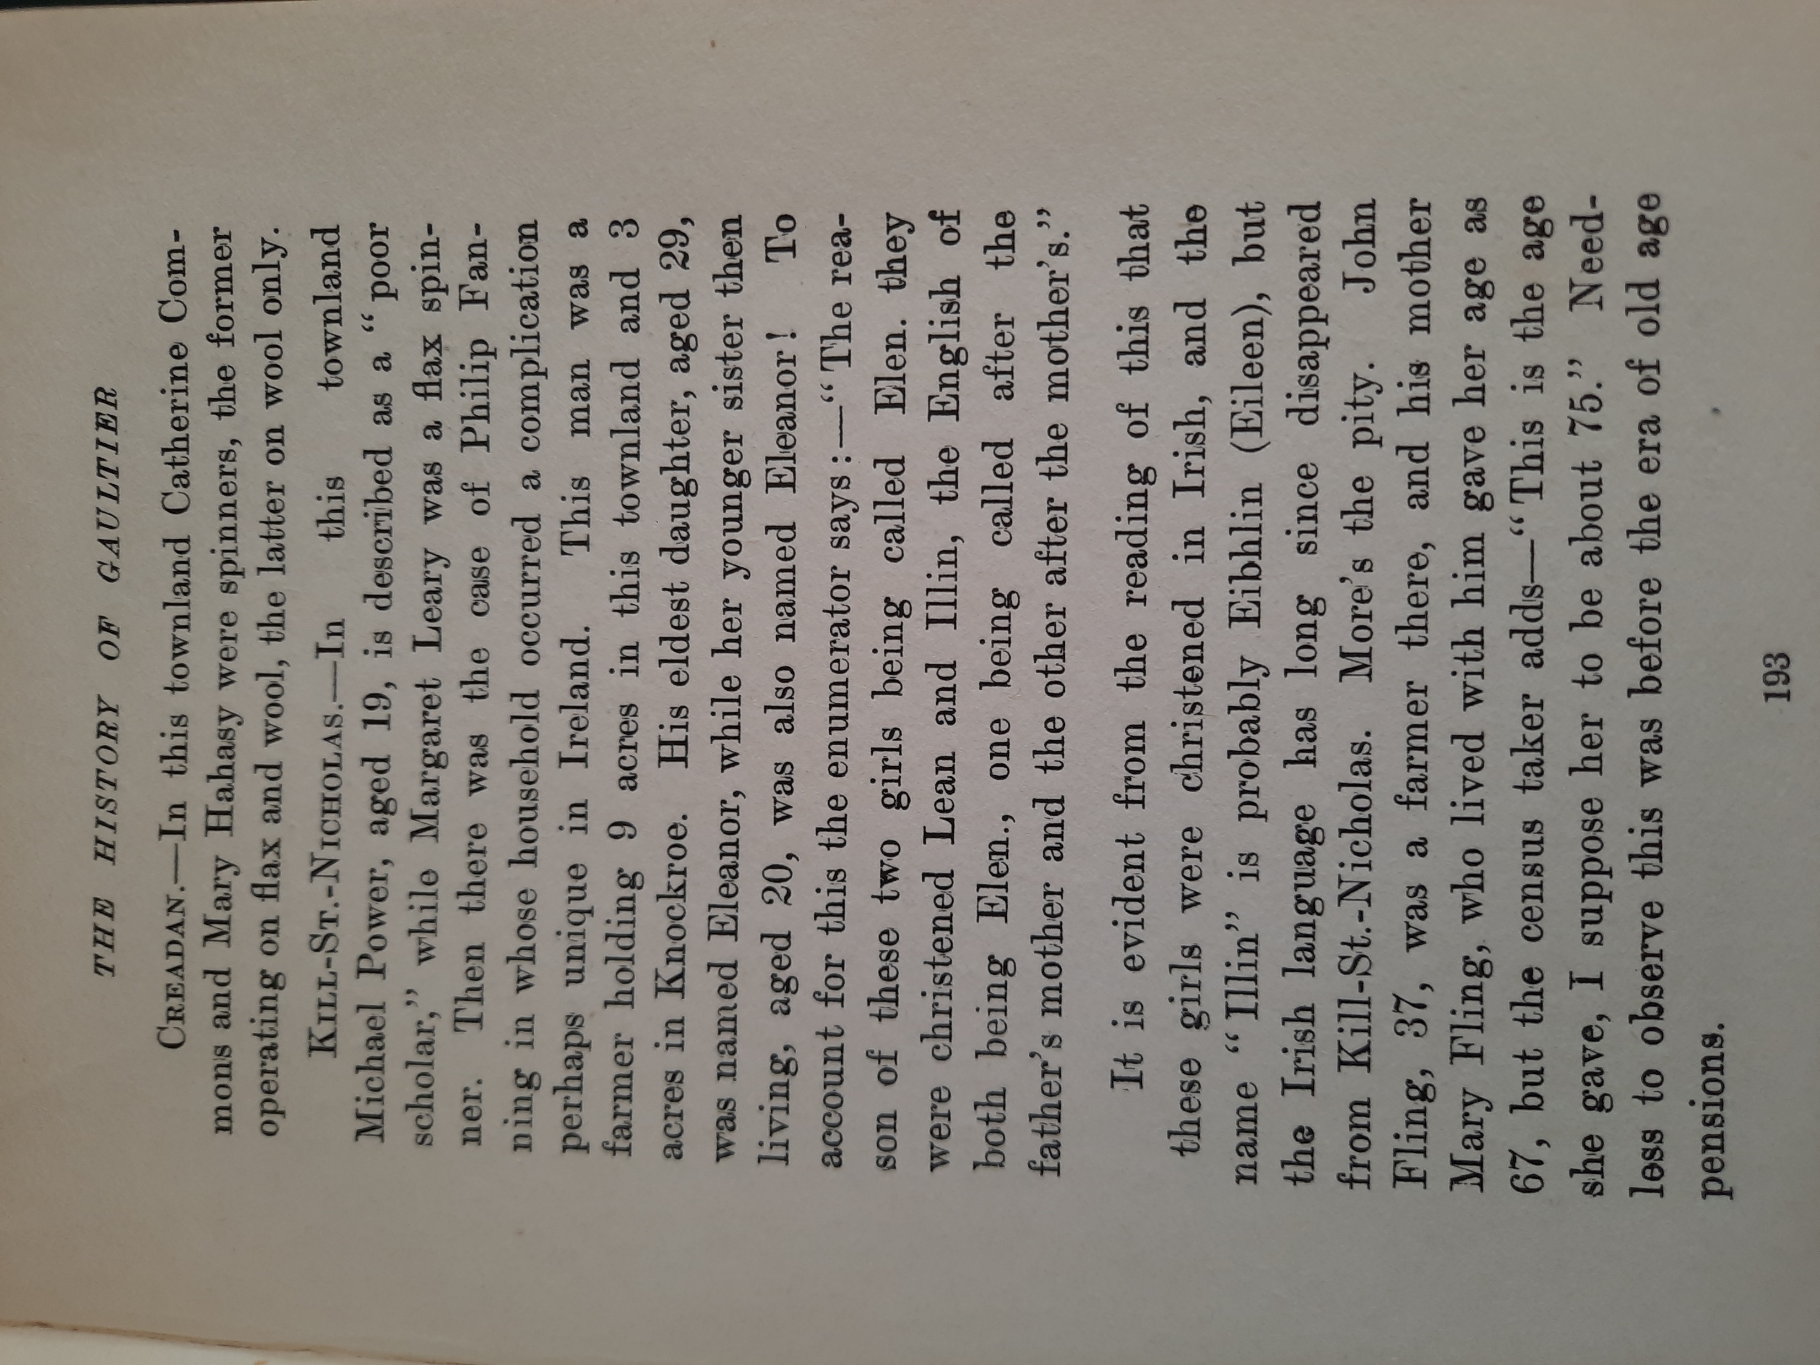

Slide 16
Family Names
Justin McCarthy
Florence / Flor McCarthy, O’Sullivan, O’Mahony, O’Driscoll
Jeffrey O’Connell
Turlough O’Breslin, O’Brien, O’Boyle, O’Connor, O’Gallagher, MacGillespie, MacSweeney
Ulick Burke

Slide 17
Meanings of Family Names
Justin comes from the Irish Saerbhreathach meaning Noble Judge;
Florence from Finghín (fair birth, fair offspring); it can also be a substitute for Flann;
Jeffrey or Geoffrey was a French or Norman name;
Turlough is one of the many names translated into English as Charles;
Ulick from Uileog, a diminutive of William.

Slide 18
LUCINDA
an 18th century poetic form of Lucy, which in turn comes from the Latin noun "Lux" meaning light, genitive form of which is "Lucis".
1901 Luighseach
2024 Laoiseach

Slide 19
Abbreviations
Jos^{h} for Joseph not Joshua
Jer^{h} for Jeremiah
Cor^{s} or Corn^{s} for Cornelius
Marg^{t} for Margaret

Slide 20
Rose = flower, rose
Rose = Hros
Old German word for Horse !

