Slide 1
Bowles
Gibney
Margaret
Bowles
1765 - 1825
John
Gibney
1770 - 1835
1829
Margaret
Fagan
1804 - 1874
Thomas
Gibney
1791 -- 1878
Bridget
Gibney
1839 - 1909
Mary
Gibney
1831
John
Gibney
1833-1910
Margaret
Plunkett
1842-1882
Patrick
Gibney
1835
Thomas
Gibney
1836
Owen
Gibney
1838
James
Gibney
1841

Slide 2
Tim Foley c. 1788 - 1863 Kate (Shea or Riordan) 1788 - 1878
Mary
Foley
1826 – 1914
(Gortnagree)
Michael
Shea
John
Foley
1828 – 1911
(Gortnagree)
Ellen
Moran
Catherine
Foley
1834 – 1921
(Letter West)
Maurice
Riordan
1831 - 1920
Patrick
Foley
1837 – 1911
(Gortnagree)
Honoria
Connell
1835 - 1887
Joanna
Foley
1841 – 1910
(Letter West)
Bartholomew
Griffin
John C
Foley
1865 – 1922
(New York)
Ellen
Maunsell
1866 – 1913
Michael P
Foley
1868 – 1947
(Caherciveen)
Mary
Sullivan
1872 – 1960
Timothy
Foley
1871 – 1909
(New York)
Joanna
Morley
1873 – 1902
Maurice
Foley
1874 – 1953
(Gortnagree)
Eliz.
McCarthy
Katherine
Foley
1877 – 1963
(Gortnagree)
Michael D
Shea
John Francis Foley
1896 - 1918
(England)
Died of ‘flu
Norah Foley
1898 – 1970
(New York)
M
Dennis Sheahan
Michael Foley
“Faldu”
1899 – 1962
(Caherciveen)
Never married
Anna Foley
1901-
(New York)
M
John Mooney
Mary Foley
1902 –
(New York)
Bridget Foley
(Sr. Ignatius)
1905 – 2003
(Belgium
San Francisco
Los Angeles)
Ellen Foley
1906 –
(New York)
Maurice Foley
1908 – 1989
(Dublin)
M
Anna (Nancy) Mahon
1905 - 1984
Catherine (Kathleen)
Foley
1910- 1959
(Dublin)
M
Dick Sweetman
Teresa Foley
1914 – 1937
(Caherciveen)
Died pregnant
Johnny Foley
(son)
Mícheál Ó Cíosóig
1928
Deirdre Foley
1938
Peter Donnelly
1939
Margaret Foley
1940
Aubrey O’Donohoe
1939
Ethna Foley
1941
Richard F Wharton
1943
Mary Foley
1943
Aileen O’Mahony
1945
Michael Foley
1944
Clíona
Ní Chíosóig
1/6/63
Colm
Ó Cíosóig
31/10/64
CP
Rosie
O’Reilly
Lí Ban
15/1/20
Fionnuala
Ní Chíosóig
1/8/68
M
Macdara
Bodeker
Oscar
29/12/09
Rónán
Ó Cíosóig
13/7/73
M
Victoria
Karakhanyan
Michael
4/12/13
Tara
Donnelly
25/10/69
M
Robert
Cline
Ruby 14/7/03
Jamie 18/7/06
Max 7/8/11
Laura
Donnelly
9/9/73
Barry Peter
O’Donohoe
21/6/70
Philip Thomas
Wharton
21/10/74
M
Carol Siobhan
Brennan
Ella Beth 11/12/19
Grace Lily 08/01/21
Paul
Foley
29/4/74
Clare
Foley
5/4/81
CP
Karol
Wątroba
Yan 13/10/23
Shane Peter
O’Donohoe
21/6/72
Aisling Mary
Wharton
21/9/68
M
Kenneth
Reilly
Killian 25/7/05
Ciara 18/10/07
Emma Maria
Wharton
30/5/73
M
Simon M
Barcoe
Lorcan 14/5/11
Finn S 31/5/13
Kate
Foley
2/9/78
M
Jose
Carruiterro
Cataleya 12/7/12

Slide 3
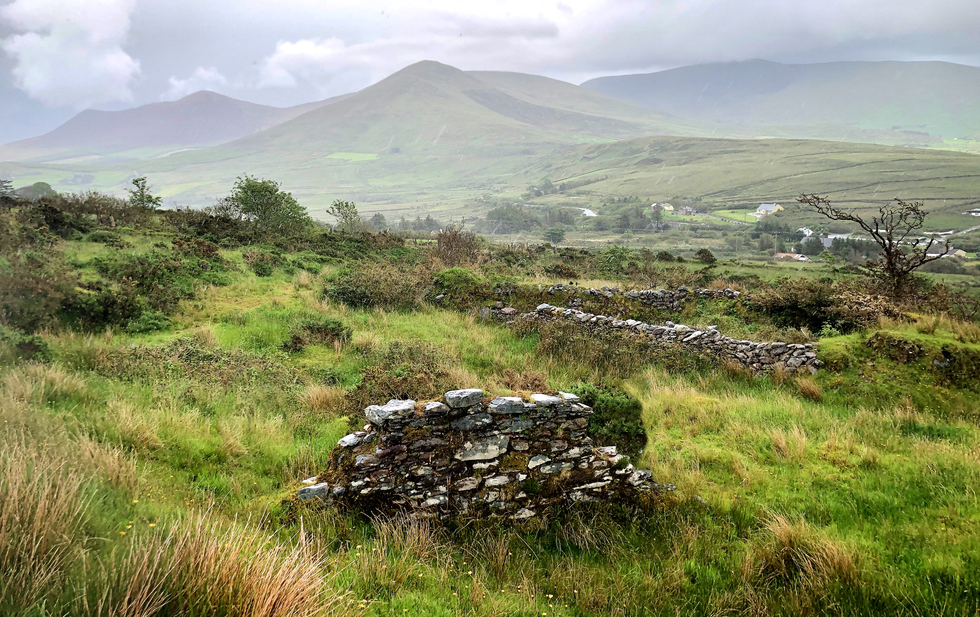
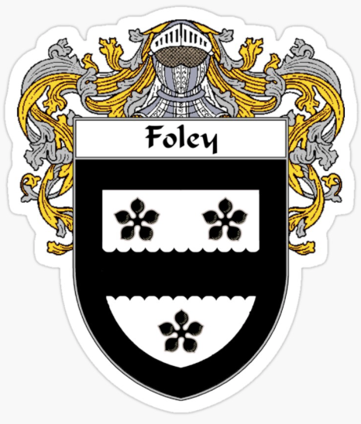
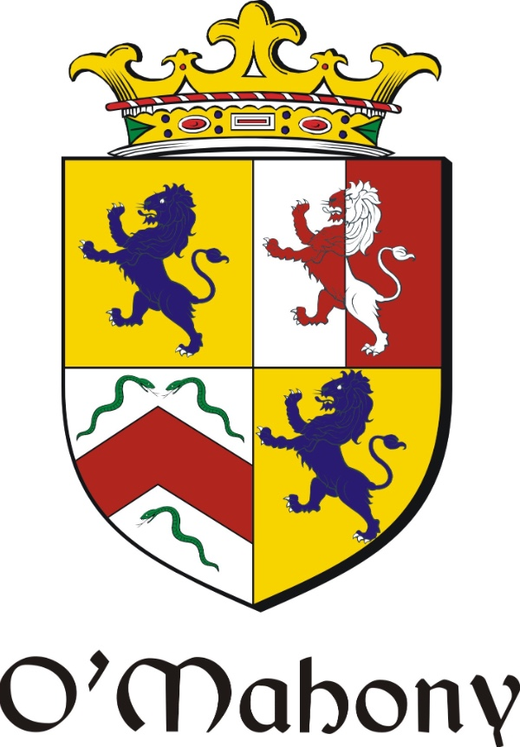
Foley Shea Connell Quinn Sullivan / McCabe Colrick Fagan Bowles Gibney Mahon Reilly / Kinmonth Screech Carroll McDonald / O’Mahony Conway O’Brien Kelleher O’Connor
Foley/O’Mahony Family Tree
William
Kinmonth
b.about 1750
Shandon
Cork City
Eliza
Foulue
Luke
McCabe
b. 1765
Kilbride
Co. Cavan
Bridget
?
b. 1766
Owen
Colrick
b. 1765
Killycully
Co. Cavan
Catherine
?
b. 1773
Margaret
Bowles
1765 - 1825
John
Gibney
1770 - 1835
Hugh
Kinmonth
Elizabeth
Screech
Bandon
Co. Cork
Timothy
Mahony
Cork
Joannah
Sullivan
Cork
b.1790
Shandon
Cork City
Tim
Foley
1788 - 1863
Cornelius Connell
Ballycarberry
Co. Kerry
Thomas
McCabe
1791 – 1878
Kilbride
Co. Cavan
Catherine
Colrick
1797-1864
Killycully
Co. Cavan
Margaret
Fagan
1804 - 1874
Thomas
Gibney
1791 – 1878
Moat
Co. Meath
Hugh
Mahon
1785 – 1875
Co. Meath
Sarah
Mahony
1813 – 1882
Cork City
Daniel
Mahony
1775 - 1840
Cork
Kate
Shea
1788 - 1878
Ellen
Quinn
Thomas
Kinmonth
1815 – 1879
Shandon
William
Carroll
1806 – 1877
Stradbally
Co. Laois
Julia
McDonald
1810 – 1876
Stradbally
Co. Laois
1840
Patrick
Foley
1837 – 1911
Gortnagree
Co. Kerry
Honoria
Connell
1835 – 1887
Gortnagree
Co. Kerry
Mary
Regan
Cork
Daniel
Mahoney
Cork
Hanorah
Kelleher
1841 – 1907
Grenagh
Co. Cork
John
O’Connor
- 1892
Killavullen
Co. Cork
Michael
Sullivan
d.c.1909
Ellen
Sullivan
1872 – 1960
Michael
McCabe
1837 – 1919
Kilbride
Co. Cavan
Bridget
Gibney
1839 – 1909
Moat
Co. Meath
Mathew
Mahon
1871 – 1919
Oldcastle
Co. Meath
Catherine
Reilly
1832 – 1887
Co. Cavan
William
Kinmonth
1842 – 1926
Shandon
Cork City
1865
Sarah
Carroll
1843 – 1934
Newport
Wales
1858
Jeremiah
Conway
1829 -1911
Aghada
Co. Cork
Mary O’Brien
1864
1865
1870
1864
Michael P
Foley
1868 – 1947
Gortnagree
Co. Kerry
1895
Mary
Sullivan
1872 – 1960
Lower Carhan
Co. Kerry
Rose
McCabe
1878 – 1960
Kilbride
Co. Cavan
1900
Thomas
Mahon
1871 – 1919
Oldcastle
Co. Meath
Elizabeth
Kinmonth
1871 – 1913
St.Peter’s
Cork City
1895
Timothy J
O’Mahony
1865 – 1942
Bunmahon Coastguard
Co. Waterford
James Leo
Conway
1869 - 1936
Cornmarket
Cork City
1897
Ellen
O’Connor
1867 - 1944
Killavullen
Co. Cork
Maurice
Foley
1908 – 1989
Gortnagree and Caherciveen
Co. Kerry
1937
Anna (Nancy)
Mahon
1905 – 1984
Oldcastle
Co. Meath
Ernest
O’Mahony
1897 – 1993
Mardyke
Cork City
1928
Norah
Conway
1905 – 1970
Montenotte
Cork City
Michael Foley
1944
Clontarf
Dublin
1972
Aileen O’Mahony
1945
Malone
Belfast
Paul
Foley
29/4/74
Kate
Foley
2/9/78
M
Jose
Carruiterro
Cataleya
12/7/12
Clare
Foley
5/4/81
CP
Karol
Wątroba
Yan Wątroba
13/10/23

