Slide 1
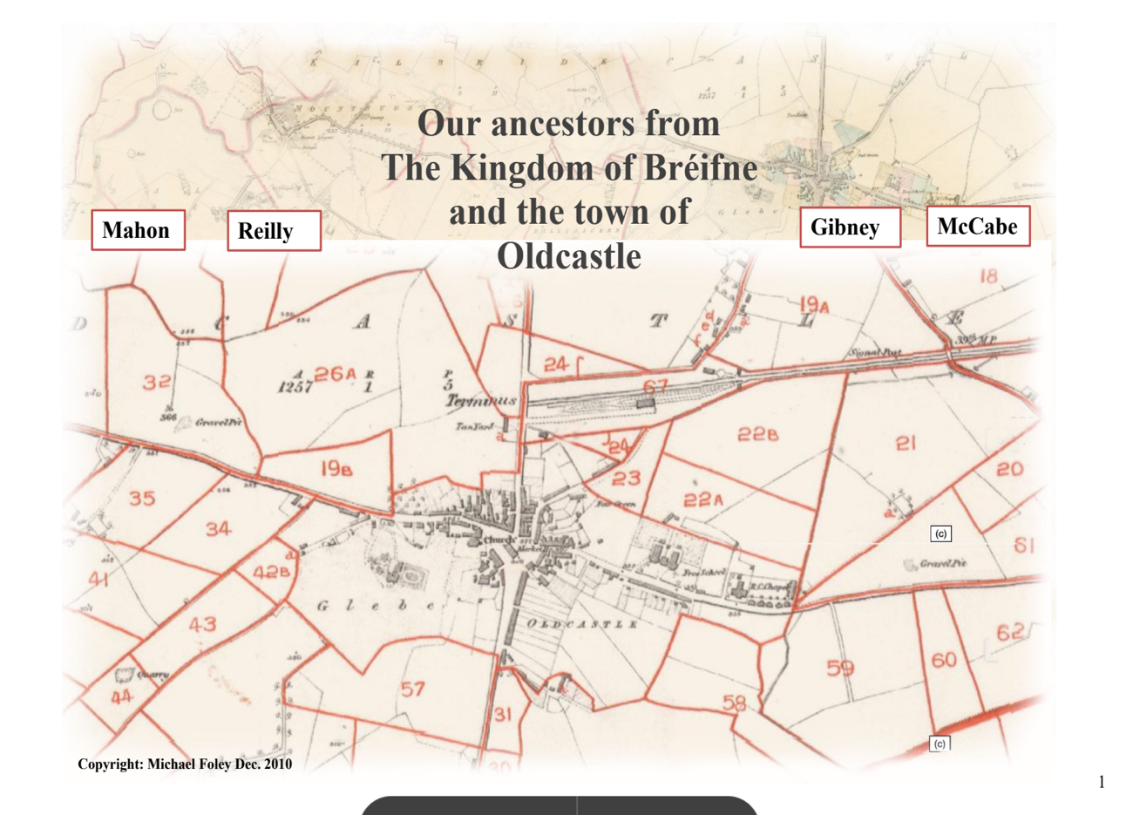
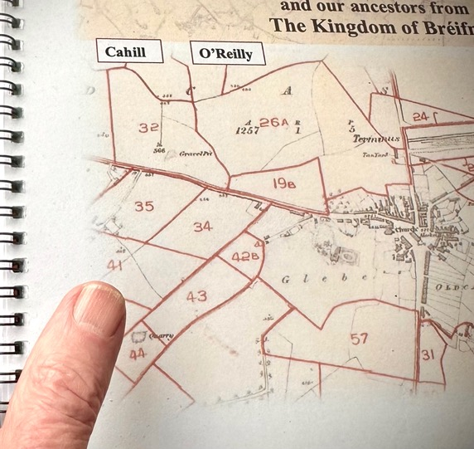
Putting
it all together -
Your Family History
in your hand
Irish Family History Society
Michael Foley
17 February 2026

Slide 2
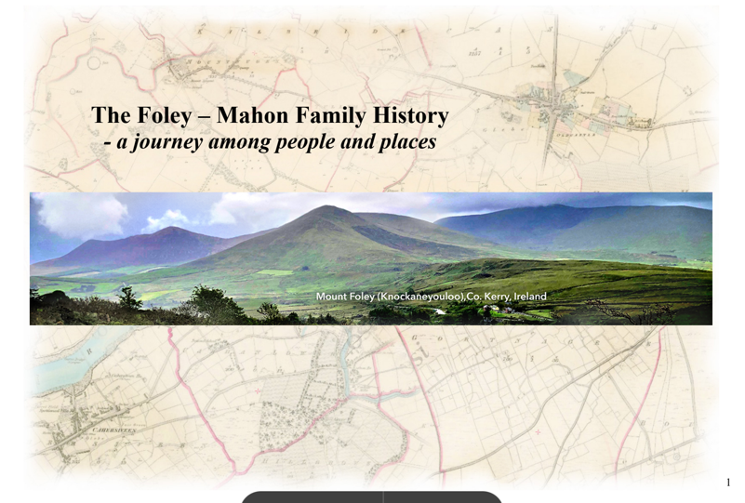
Make different editions depending on audience

Slide 3
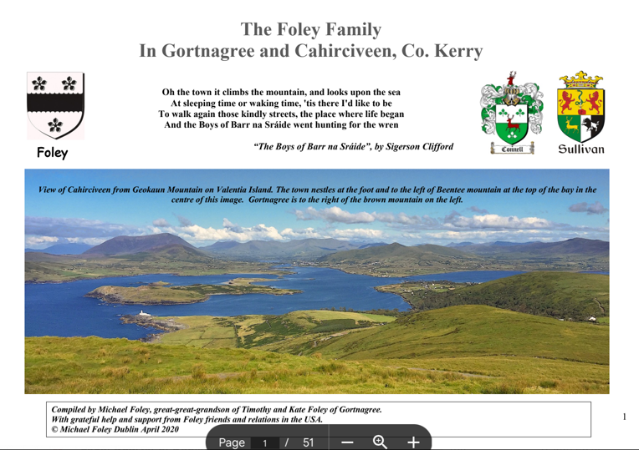

Slide 4


Slide 5
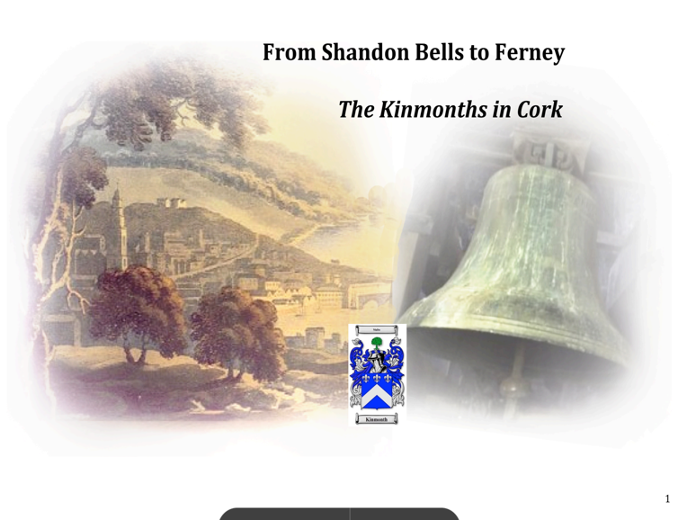

Slide 6
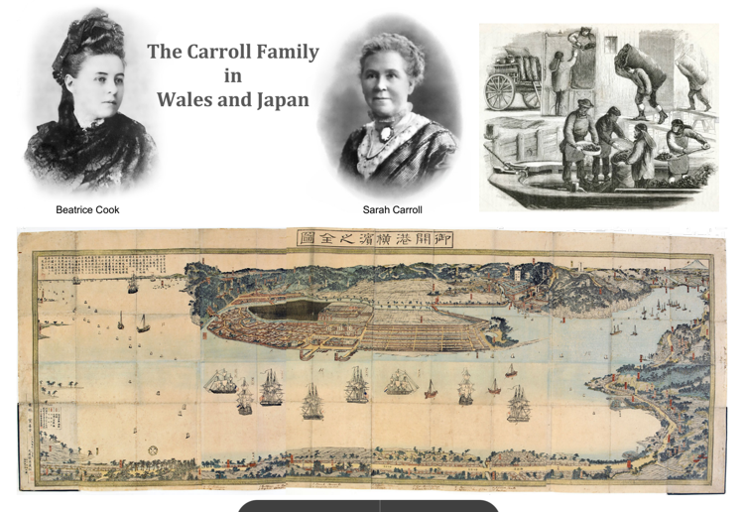

Slide 7
Creating you Family History Book
So you’ve done years of research and you’re the go-to person for family history matters.
But the results of your research are all over the place - in filing cabinets or in boxes.
Wouldn’t it be nice to have it all pulled together and printed in a print shop with a spiral binding and glossy cover – so cost effective that you can get multiple copies to give as gifts to family?
What I am suggesting is not a work of prose to be read from cover to cover – it’s more a reference book that you can pore over in sections with a sibling or cousin.
I’m proposing a hard copy version of your history in one document but to get there you need to have them as electronic/digital files
You’ll end up with a book, but it’s a compilation of pieces consisting of bits of text, some records, a picture or two or three, encompassing a couple and their children, maybe a map and image of where they lived.
And all of these pieces you can consider as objects to be moved around a page. Little skill is needed.

Slide 8
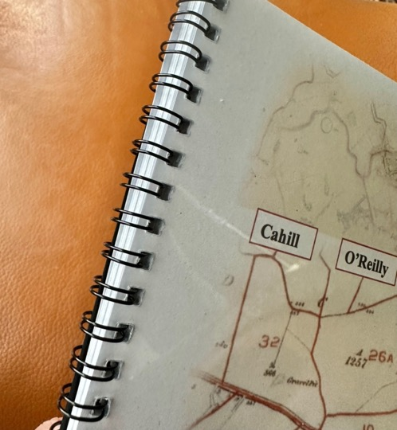
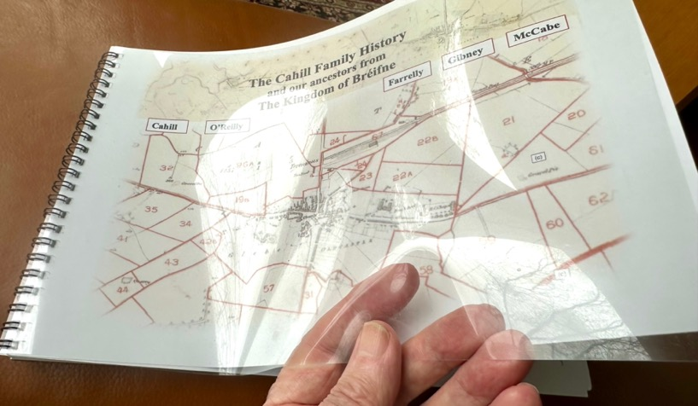
Print Shop
Quality
Glossy cover
Spiral wire bound

Slide 9
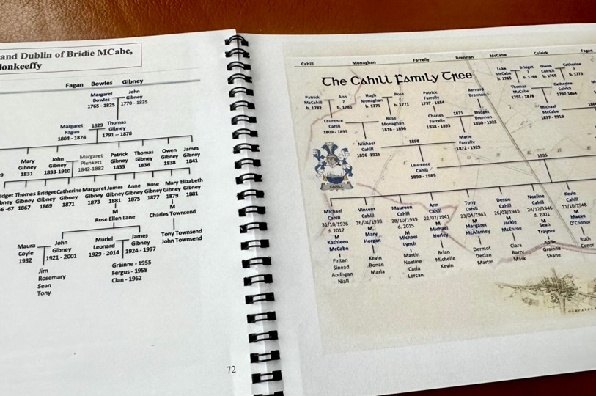
Opening flat for easy reading of family trees

Slide 10
The book will consist of objects which can be moved around:
Text – all text will be inputted as ‘text boxes’ – with or without borders: titles, body text, captions
Shapes – coloured, arrows, rectangles and ovals
Screenshots – of records (BMD), census returns, maps (Griffith’s valuations/OSI).
Photos – old family photos, cousins, houses
Family trees – screenshots of slides - PowerPoint, Keynote or Google
Each page is a canvas where you insert these ‘objects’.
Start by saving online records as named screenshots in folders

Slide 11
Creating your Family History Book
Open a new Word document
Under File click on ‘page setup’ option
Select A4 or US Letter Paper option
Select Landscape orientation
Then go to ‘Layout’ and ‘Margins’ and choose ‘Narrow’ – (you’re preparing a ‘book’ not writing a letter.)
Under Insert select ‘Page numbers’
Decide to have the book spine on top or at left and leave a little space for the binding. (Wire binding will let the pages lie flat)
Create a lot of blank pages in advance
Now you are set for creating your book

Slide 12
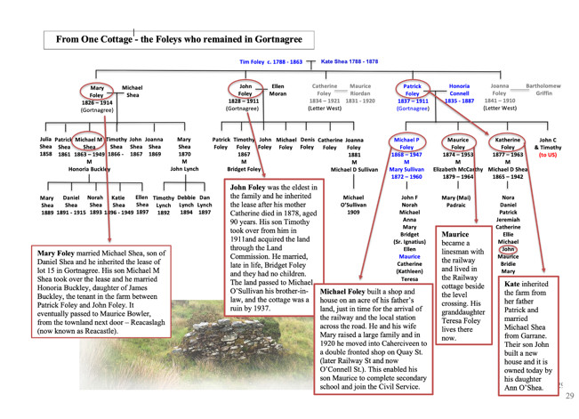
Create multiple partial family trees in PowerPoint, make a screenshot of them, and add mini-story
summaries to them in outlined text boxes in the Word document
Insert ‘shapes’ like arrows and ovals for emphasis.
Like this

Slide 13
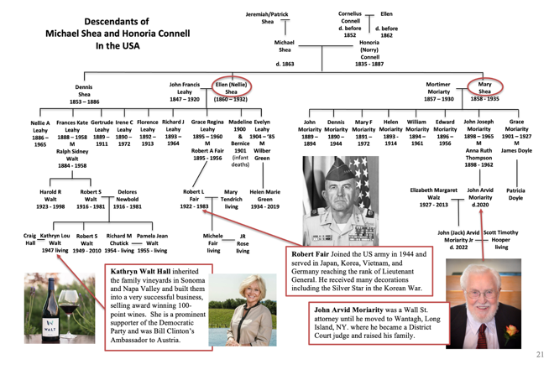
or this

Slide 14
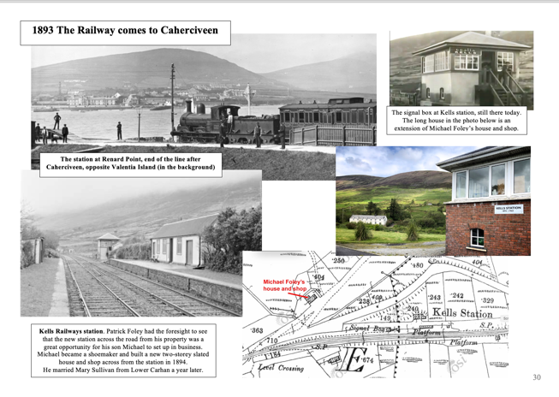
Tell a story in one page with images, and titles in text boxes.

Slide 15
Screenshots of online records
How to Screenshot a Portion of the Screen Directly in Windows
Press Windows key + Shift + S
Your screen will dim and a small toolbar appears at the top.
Choose the first option: Rectangular Snip (default).
Click and drag to select only the area you want.
Release the mouse — the screenshot is taken instantly.
A small preview appears in the bottom-right corner.
Click it to edit or save.
To save it as a JPEG
After the preview opens, click the Save icon.
Choose the JPEG (.jpg) format in the dropdown.
Save to your desired folder – rename it, eg, as : Birth Maurice Foley 1908

Slide 16
Bowles
Gibney
Download this PowerPoint template for making your family tree. (it accompanies my first presentation on the IFHS website)
All the names are in text boxes which can be moved around with your mouse.
Simply copy and paste a name (blue for direct ancestors, black for their siblings and grey for all spouses) and change the names and dates.
No formatting needed!
Copy and paste the family tree lines too and adjust.
Use the red horizontal line below to line up names (grab it and move up under the names and nudge each into place with the arrow keys on your keyboard).
Margaret
Bowles
1765 - 1825
John
Gibney
1770 - 1835
1829
Margaret
Fagan
1804 - 1874
Thomas
Gibney
1791 -- 1878
Bridget
Gibney
1839 - 1909
Mary
Gibney
1831
John
Gibney
1833-1910
Margaret
Plunkett
1842-1882
Patrick
Gibney
1835
Thomas
Gibney
1836
Owen
Gibney
1838
James
Gibney
1841

Slide 17
Mahon
Reilly
McCabe
Colrick
Fagan
Bowles
Gibney
Luke
McCabe
b. 1765
Bridget
?
b. 1766
Owen
Colrick
b. 1765
Catherine
?
b. 1773
Margaret
Bowles
1765 - 1825
John
Gibney
1770 - 1835
The complete tree from which the template was made
James
McCabe
1786
Michael
McCabe
1792
Catherine
McCabe
1794
Mary
McCabe
1796
Pat
McCabe
1801
Luke
McCabe
1807
Thomas
McCabe
1791 - 1878
Catherine
Colrick
1797-1864
Ellen
Colrick
1799
Margaret
Fagan
1804 - 1874
Thomas
Gibney
1791 -- 1878
Hugh
Mahon
1875 - 1885
1829
Mathew
Mahon
1855
Catherine
Reilly
1832 - 1887
Philip
McCabe
1832
Mary
McCabe
1839
Michael
McCabe
1837 - 1919
1864
Bridget
Gibney
1839 - 1909
Mary
Gibney
1831
John
Gibney
1833-1910
Margaret
Plunkett
1842-1882
Patrick
Gibney
1835
Thomas
Gibney
1836
Owen
Gibney
1838
James
Gibney
1841
1900
Catherine
McCabe
1864
Margaret
McCabe
1869
Mary
McCabe
1871
Bridget
McCabe
1873
Mary Anne
O’Reilly
1864
Anne
McCabe
1879
James
McCabe
1883
Bridget
Gibney
1866 -67
Thomas
Mahon
1871 - 1919
Rose
McCabe
1878 - 1960
Patrick
McCabe
1867
Thomas
Gibney
1867
Bridget
Gibney
1869
Catherine
Gibney
1871
Margaret
Gibney
1873
James
Gibney
1881
Anne
Gibney
1875
Rose
Gibney
1877
Mary
Gibney
1879
Elizabeth
Gibney
1881
M
Rose Ellen Lane
M
Charles Townsend
Maurice
Foley
1908-1984
1937
Anna (Nancy)
Mahon
1905 - 1984
Kathleen
Mahon
1901-1997
Tom
Kelly
1882-1955
Madge
Mahon
1903 –1964
Tony
Mahon
1906 -1969
Michael
McCabe
1911
Bridget (Cissie)
McCabe
1913 - 2003
1935
Lawrence
Cahill
1899-1989
Maura
Coyle
1932
John
Gibney
1921 - 2001
Muriel
Leonard
1929 - 2014
James
Gibney
1924 - 1997
Tony Townsend
John Townsend
Deirdre - 1939
Maggie - 1940
Ethna - 1941
Mary - 1943
Michael - 1944
Tom – 1927 - 2012
Vincent – 1929 - 2013
Rita – 1931 - 1967
Feichin – 1933 - 1948
Donal K – 1934 - 2010
Gerard – 1936 – 2003
Bernard F – 1940
Malachy – 1941
Phelim - 1943
Michael
Vincent
Mary (Maureen)
Anne
Lawrence (Tony)
Des
Noleen
Kevin
Martin
Gerry
Brian
Barbara
Jim
Rosemary
Sean
Tony
Gráinne - 1955
Fergus - 1958
Cian - 1962
NB: Direct ancestors of Foleys in blue

Slide 18
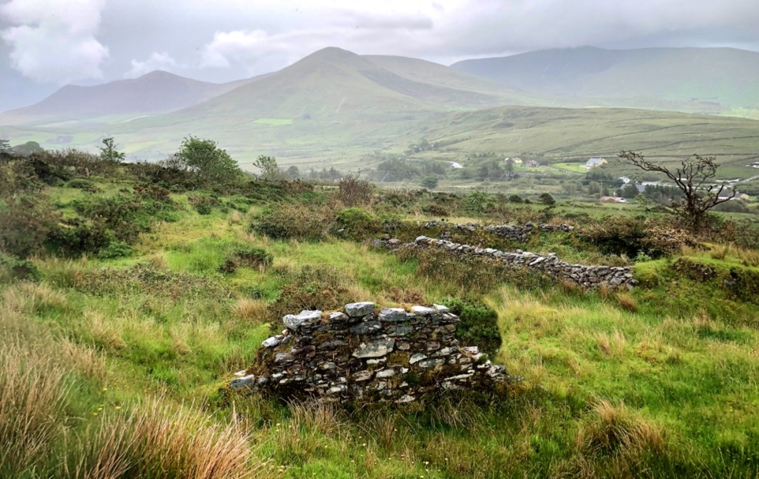


Foley Shea Connell Quinn Sullivan / McCabe Colrick Fagan Bowles Gibney Mahon Reilly / Kinmonth Screech Carroll McDonald / O’Mahony Conway O’Brien Kelleher O’Connor
Foley/O’Mahony Family Tree
William
Kinmonth
b.about 1750
Shandon
Cork City
Eliza
John ?
Foulue
Luke
McCabe
b. 1765
Kilbride
Co. Cavan
Bridget
?
b. 1766
Owen
Colrick
b. 1765
Killycully
Co. Cavan
Catherine
?
b. 1773
Margaret
Bowles
1765 - 1825
John
Gibney
1770 - 1835
Hugh
Kinmonth
Elizabeth
Screech
Bandon
Co. Cork
Timothy
Mahony
Cork
Joannah
Sullivan
Cork
b.1790
Shandon
Cork City
Tim
Foley
1788 - 1861
Cornelius Connell
Ballycarbery
Co. Kerry
Thomas
McCabe
1791 – 1878
Kilbride
Co. Cavan
Catherine
Colrick
1797-1864
Killycully
Co. Cavan
Margaret
Fagan
1804 - 1874
Thomas
Gibney
1791 – 1878
Moat
Co. Meath
Hugh
Mahon
1785 – 1875
Co. Meath
Sarah
Mahony
1813 – 1882
Cork City
Daniel
Mahony
1775 - 1840
Cork
Kate
Riordan
1788 - 1878
Ellen
Quinn
Thomas
Kinmonth
1815 – 1879
Shandon
William
Carroll
1806 – 1877
Stradbally
Co. Laois
Julia
McDonald
1810 – 1876
Stradbally
Co. Laois
1840
Patrick
Foley
1837 – 1911
Gortnagree
Co. Kerry
Honoria
Connell
1835 – 1887
Gortnagree
Co. Kerry
Mary
Regan
Cork
Daniel
Mahoney
Cork
Hanorah
Kelleher
1841 – 1907
Grenagh
Co. Cork
John
O’Connor
- 1892
Killavullen
Co. Cork
Michael
Sullivan
d.c.1909
Ellen
Sullivan
1872 – 1960
Michael
McCabe
1837 – 1919
Kilbride
Co. Cavan
Bridget
Gibney
1839 – 1909
Moat
Co. Meath
Mathew
Mahon
1871 – 1919
Oldcastle
Co. Meath
Catherine
Reilly
1832 – 1887
Co. Cavan
William
Kinmonth
1842 – 1926
Shandon
Cork City
1865
Sarah
Carroll
1843 – 1934
Newport
Wales
1858
Jeremiah
Conway
1829 -1911
Aghada
Co. Cork
Mary O’Brien
1864
1865
1870
1864
Michael P
Foley
1868 – 1947
Gortnagree
Co. Kerry
1895
Mary
Sullivan
1872 – 1960
Lower Carhan
Co. Kerry
Rose
McCabe
1878 – 1960
Kilbride
Co. Cavan
1900
Thomas
Mahon
1871 – 1919
Oldcastle
Co. Meath
Elizabeth
Kinmonth
1871 – 1913
St.Peter’s
Cork City
1895
Timothy J
O’Mahony
1865 – 1942
Bunmahon Coastguard
Co. Waterford
James Leo
Conway
1869 - 1936
Cornmarket
Cork City
1897
Ellen
O’Connor
1867 - 1944
Killavullen
Co. Cork
Maurice
Foley
1908 – 1989
Gortnagree and Caherciveen
Co. Kerry
1937
Anna (Nancy)
Mahon
1905 – 1984
Oldcastle
Co. Meath
Ernest
O’Mahony
1897 – 1993
Mardyke
Cork City
1928
Norah
Conway
1905 – 1970
Montenotte
Cork City
Pedigree Tree for my children (direct ancestors only)
Michael Foley
1944
Clontarf
Dublin
1972
Aileen O’Mahony
1945
Malone
Belfast
Paul
Foley
29/4/74
Kate
Foley
2/9/78
M
Jose
Carruiterro
Cataleya
12/7/12
Clare
Foley
5/4/81
CP
Karol
Wątroba
Yan Wątroba
13/10/23

Slide 19
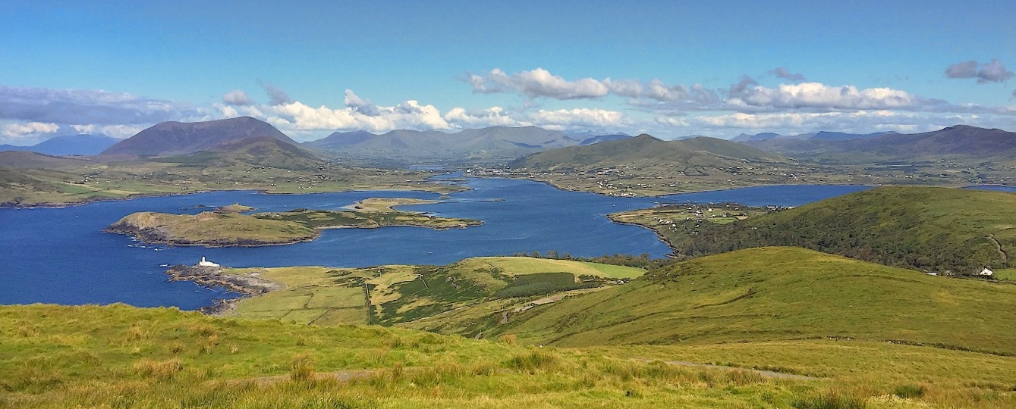

Oh the town it climbs the mountain, and looks upon the sea
At sleeping time or waking time, 'tis there I'd like to be
To walk again those kindly streets, the place where life began
And the Boys of Barr na Sráide went hunting for the wren
“The Boys of Barr na Sráide”, by Sigerson Clifford
Thank you
michaeljfoley@mac.com

